Slide 1

Salary Survey 2021
Name: Shahin Sulaiman M
Date:13.02.2025

Slide 2
Dataset Overview
Age Range: The age group of the individual.
Industry: The sector in which the individual works.
Job Title: The official position held by the individual.
Annual Salary: The individual’s annual salary or earnings.
Additional Monetary Compensation: Extra earnings beyond the base salary
Currency: The currency in which salary and compensation are reported.
Country: The country where the individual works.
State: The state or province of employment
City: The city where the individual works
Years of Professional Experience Overall: The total number of years the individual has worked professionally.
Years of Professional Experience in Field: The number of years the individual has worked in their specific field.
Highest Level of Education Completed: The highest degree or educational level attained.
Gender: The gender identity of the individual.

Slide 3
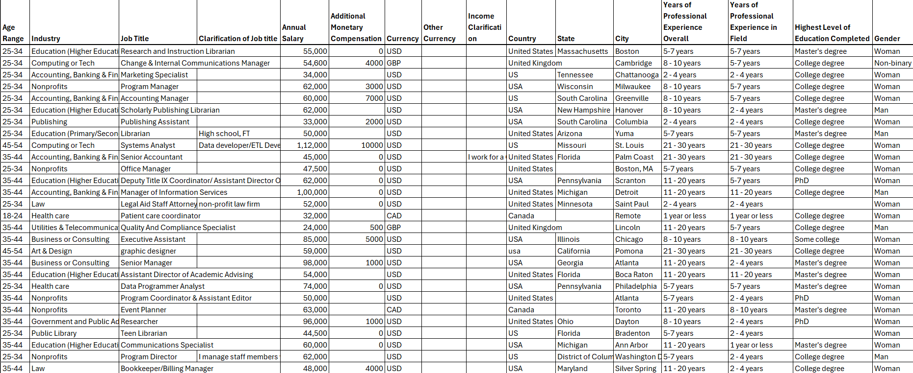
Dataset

Slide 4
Data Cleaning
Identifying and Handling Missing Data
Removing Duplicates
Standardizing Data Formats
Handling Outliers
Validating and Verifying Data
Standardizing Text Data (Case Consistency, Spacing, Abbreviations)
Fixing Inconsistent Categorical Values
Replacing Blanks with “Unknown”

Slide 5
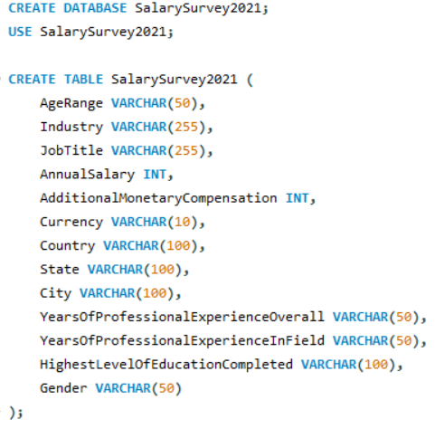
Data Importing In MySQL
Create a database in MySQL
Create a Table and Attributes
Import a cleaned CSV file to the MySql workbench using load data
Execute the 10 queries in MySQL

Slide 6
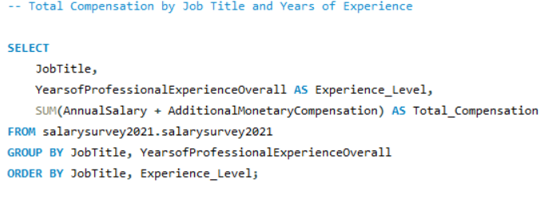
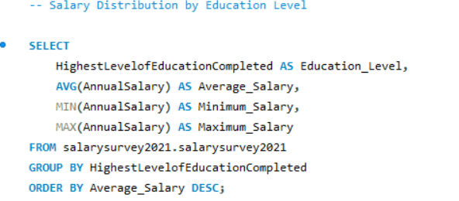
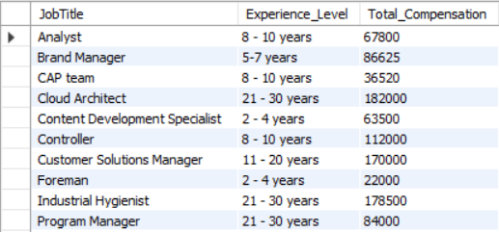
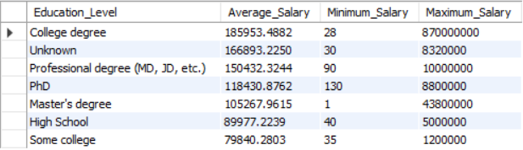
Some of the Following Queries

Slide 7
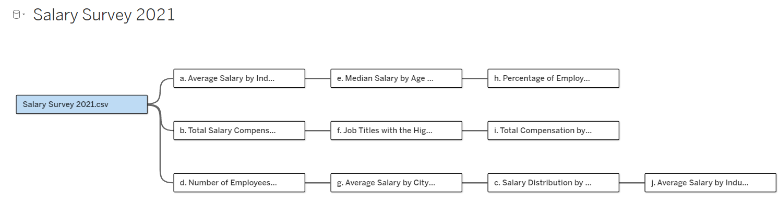
Tableau
Importing the CSV files containing the query results into Tableau.
Connecting a relationship between 10 queries.
Create an interactive dashboard that visualizes key insights from the data, such as salary distributions, gender comparisons, and the impact of education on salary.

Slide 8
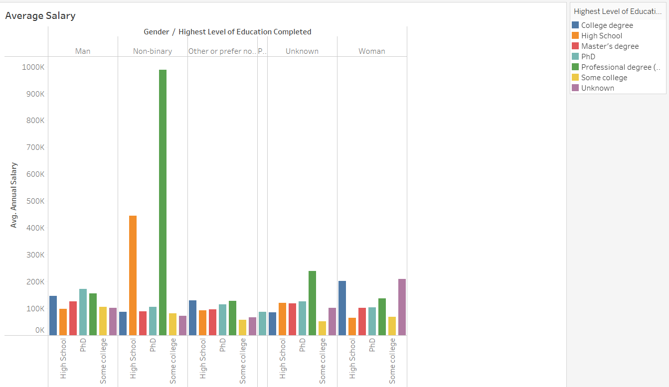
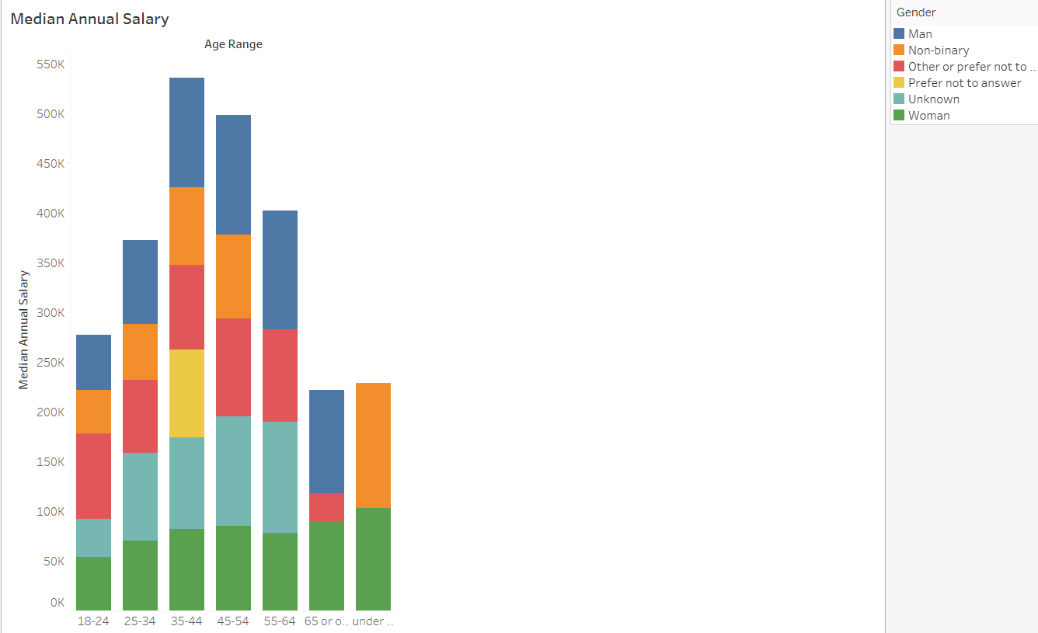
Visualizations

Slide 9
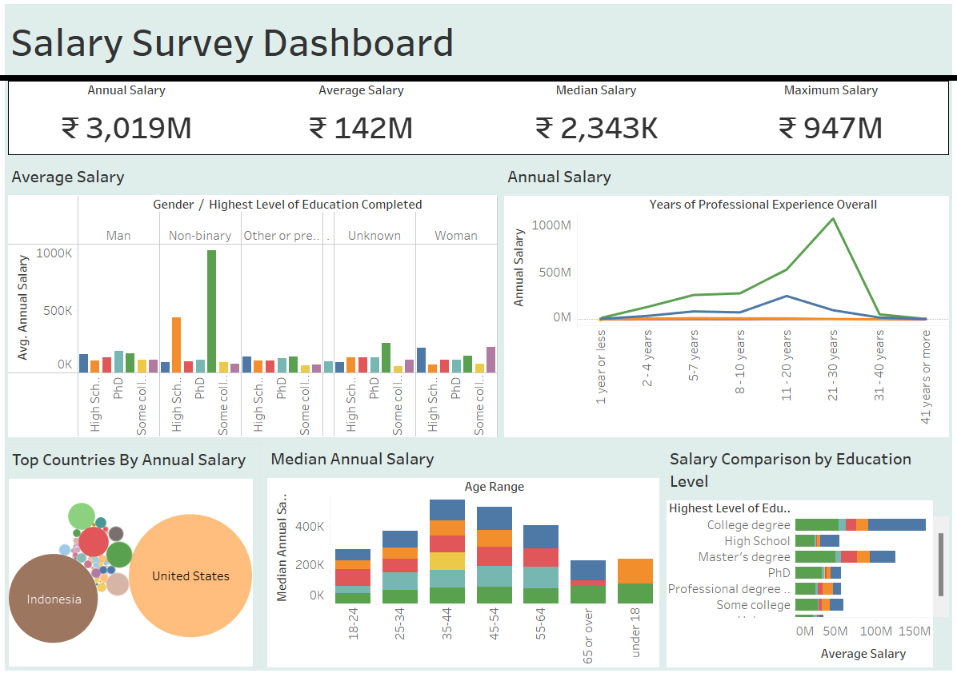
Tableau Dashboard

Slide 10
Key Insights
Education Level:
A significant number of respondents hold a Master's degree or higher, indicating a highly educated workforce.
Higher education levels often correlate with higher salaries and more senior positions.
Age and Experience:
The majority of respondents fall within the 25-34 age range, indicating a younger workforce.
Many professionals have 5-7 years of overall experience, suggesting a mid-level career stage.
Geographical Distribution:
The data includes professionals from various countries, including the United States, United Kingdom, Canada, and others.
Within the U.S., states like Massachusetts, California, and New York have a high concentration of respondents.

Slide 11
Conclusion
Salaries vary significantly across industries, with Tech, Engineering, and Senior Management roles offering the highest compensation. This highlights the lucrative nature of these fields.
Higher education levels and more years of experience generally correlate with higher salaries and more senior positions. This underscores the importance of continuous learning and career development.
While there is a strong presence of women in various roles, certain industries still show a gender disparity, particularly in senior technical positions. Efforts to promote gender diversity and inclusion in these fields are essential.

Slide 12


